Slide 1
IMAGE Steganography

Slide 2
Content
Definition of image steganography
Advantages
Limitation
Block diagram
Technique
Error analysis

Slide 3
Image steganography
Definition :
Steganography is the art of “concealed writing and it refers to techniques that hide information inside objects known as “cover object”.
In Image Steganography the cover object is an image and the message object can be a text or an image .

Slide 4
Advantages of steganography
Difficult to detect .Only receiver can detect
Provides better security for data sharing

Slide 5
limitations of steganography
The confidentiality of information is maintained by the algorithm and if algorithm are known then this technique is of no use

Slide 6
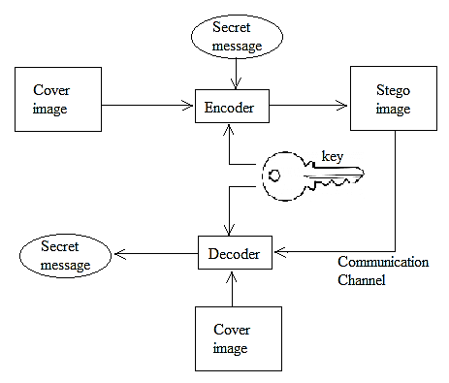
Block Diagram

Slide 7
Technique
Every image consists of MSB(Most Significant bit) and LSB(Least Significant bit)
In the project the LSB of the cover image is replace by the MSB of the message image , we get a stego image which contain both cover image and message image
In the same way we get the extracted image form the stego image

Slide 8
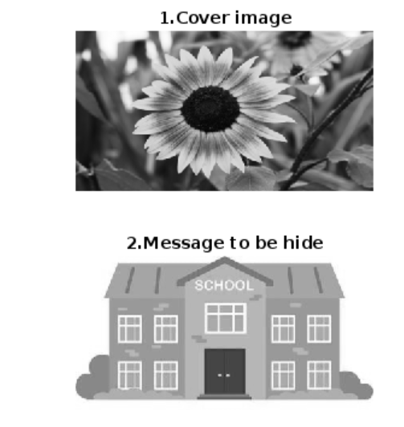
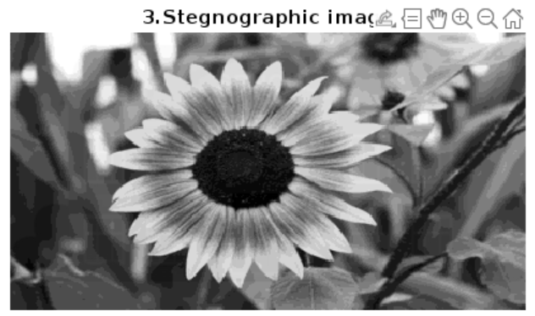
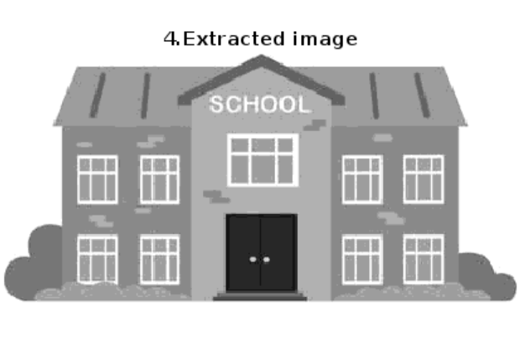

Slide 9
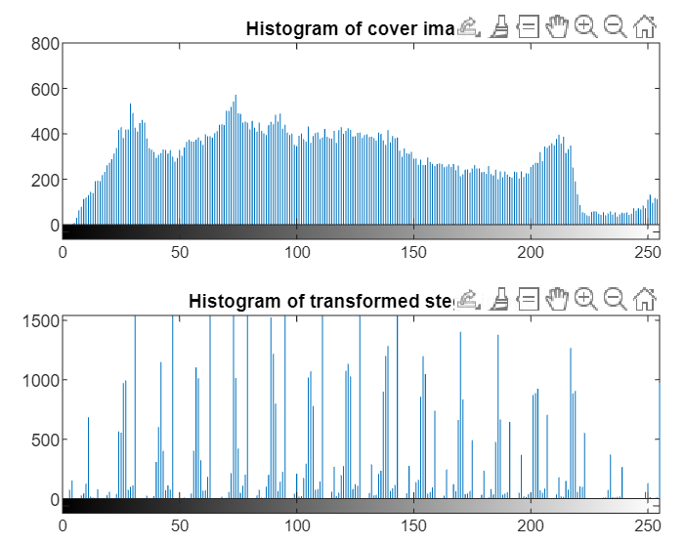
to know we the stego image has message image

Slide 10
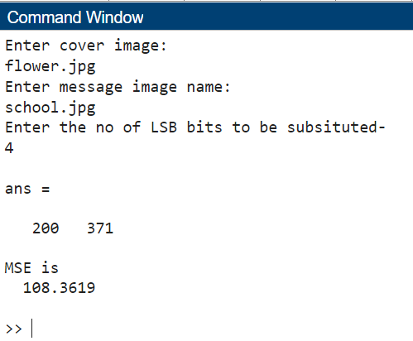
Error analysis
MEAN SQUARE ERROR:
It is defied as the square or error between message image and stego image
The lower the error the better the output we get

Slide 11
Conclusion
Steganography is the art and science of writing hidden message that no one apart form the sender and receiver , suspect the existence of the message .
The MSE error in the extracted image the lower mse the better output we can get. It is a vital tool for securing data and protecting digital media.
As technology continues to advance, so do the techniques and challenges of image steganography.

Slide 12
Thank you

